Slide 1
PlacementIQ Enterprise
AI-Powered Placement and Career Readiness System
Team Members: Guided by:
Shaganti Vivek Goud 23EG105F59 Dr. Kamalakar Ramineni
Puram Preethi 23EG105F52 Assistant Professor
Akshaya Reddy 23EG105F03
Bandari laxmisri 23EG105F09

Slide 2
ABSTRACT
PlacementIQ Enterprise centralizes campus drives, company details, eligibility, packages, and alumni.
It analyzes CGPA, skills, resume, projects, internships, and coding profiles to assess placement readiness.
AI predicts Eligible, Nearly Eligible, Can Become Eligible, and Not Eligible companies while identifying skill gaps.
Provides Company Match Score, Placement Readiness, Salary Prediction, Interview Readiness, and personalized roadmaps.

Slide 3
INTRODUCTION
Campus placement is the most important milestone for engineering students, but drive details reach them through portals, spreadsheets, e-mail and WhatsApp groups.
Students rarely know which companies they are eligible for, why they fall short, or which skill to improve first.
PlacementIQ Enterprise is an AI-powered placement platform: each college onboards its own students, posts drives and monitors readiness by year, branch and section.
For every student and company it gives an explainable category (Eligible, Nearly Eligible, Can Become Eligible, Not Eligible) with the exact gaps and a personalised plan.
66 recruiters scored
4 eligibility categories
4 user roles
8 skill areas tracked

Slide 4
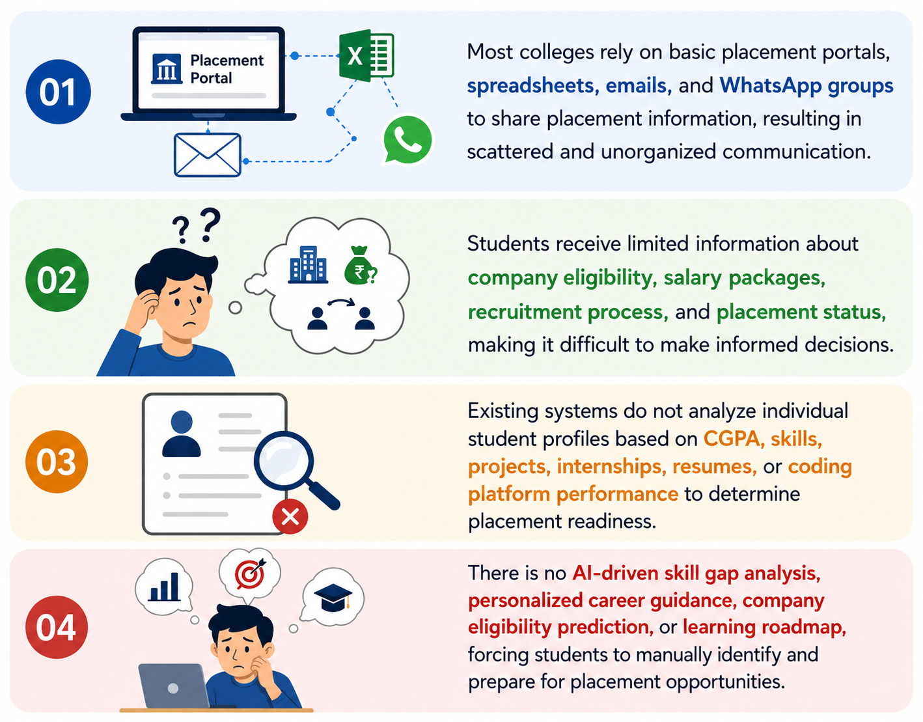
PROBLEM STATEMENT
Students have limited information about campus placement opportunities, company eligibility, salary packages, and recruitment processes.
Existing systems do not evaluate individual placement readiness based on academics, skills, projects, internships, and coding profiles.
Students cannot easily identify eligible companies, skill gaps, or the improvements required to secure desired placements.
An AI-powered Placement Operating System is needed to provide company recommendations, skill-gap analysis, personalized roadmaps, alumni mentorship, and real-time placement insights.

Slide 5
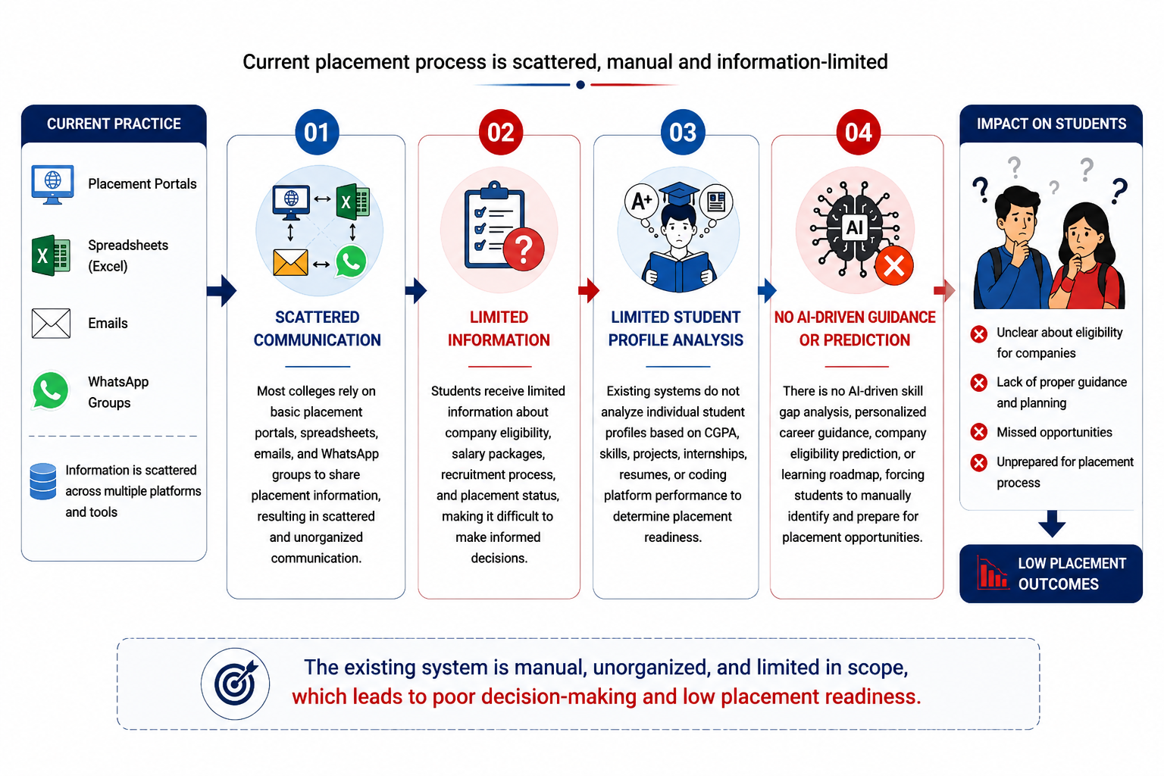
EXISTING SYSTEM

Slide 6
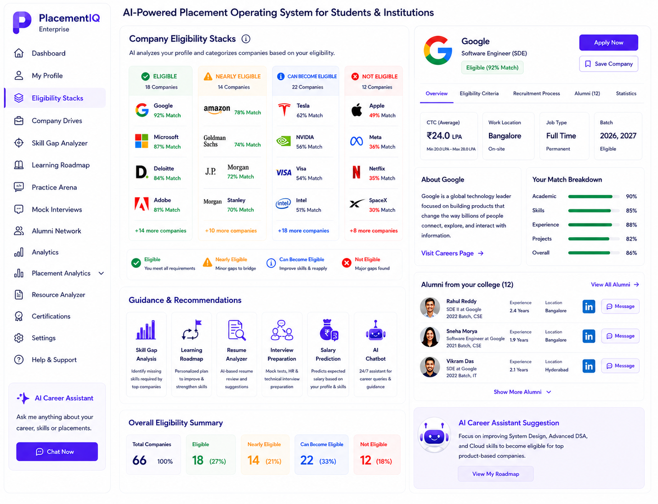
PROPOSED SYSTEM

Slide 7
LITERATURE SURVEY
Year | Publisher | Author | Title | Method | Merits | Demerits
2025 | IEEE (ICISS) | F. B. Kunwar et al. | Enhanced Student Placement Prediction and Skill Recommendation System | CNN-BiLSTM with attention | Predicts placement and recommends skills | Black-box model; no per-company reason
2024 | ACM Computing Surveys | Y. Mashayekhi et al. | A Challenge-based Survey of E-recruitment Recommendation Systems | Survey of job and candidate recommenders | Maps open challenges: sparsity, fairness, explainability | Recruiter-centric; no student guidance
2023 | Springer (IJAIED) | A. José-García et al. | C3-IoC: A Career Guidance System for Assessing Student Skills | ML skill similarity + job-role network | Links student skills to IT job roles | Not tied to campus drives or eligibility rules
2023 | IEEE (CSITSS) | M. S. A. Basha et al. | Unraveling Campus Placement Success with Predictive ML Models | EDA + supervised classifiers | Shows academic factors predict placement | Only placed or not placed; no improvement plan
2023 | IEEE (UBMK) | S. Tanberk et al. | Resume Matching Framework via Ranking and Sorting Using NLP and Deep Learning | NLP + BERT resume ranking | Semantic resume and JD matching | Ranks for recruiters; no feedback to students
2021 | IEEE Access | R. Alamri, B. Alharbi | Explainable Student Performance Prediction Models: A Systematic Review | Systematic literature review | Catalogues explainability techniques | Few deployed explainable models found

Slide 8
SOFTWARE AND HARDWARE REQUIREMENTS
Software Requirements
Frontend: React 18, TypeScript, Vite 5, Tailwind CSS, Recharts
Backend: Supabase (PostgreSQL, Auth, Storage, row-level security)
Serverless API: Vercel Edge Functions (Node.js runtime)
AI: Groq LLM API (gpt-oss-120b, fallback gpt-oss-20b)
Parsing: pdf.js (PDF) and mammoth (DOCX) resumes
Integrations: GitHub, LeetCode, Codeforces, CodeChef
Tools: VS Code, Git and GitHub, Node.js 20+, npm
Client: latest Chrome, Edge, Firefox or Safari
Hardware Requirements
Developer PC: Intel i5 / AMD Ryzen 5 / Apple M1 or better
RAM: 8 GB minimum (16 GB recommended)
Storage: 10 GB free (SSD preferred)
Internet: stable broadband for cloud services
End users: any laptop or phone with a modern browser (4 GB RAM, 360 px+ screen)
Server: none on premises; fully managed cloud (Supabase + Vercel)

Slide 9
MODULES
Student Module
Profile, resume and coding links
Eligibility stacks for 66 companies
Skill gaps, roadmap, practice
What-If simulator, AI assistant
Apply to campus drives
Placement Cell Module
Roster upload with sections
Year / branch / section monitoring
Student rankings and filters
Post drives, manage applicants
Add recruiters, view feedback
Recruiter Module
Post drives for own company
Ranked applicants with match %
Full profiles of applicants only
Shortlist, interview, offer
Platform Admin Module
Create colleges and logins
Plans, seats and pricing
Usage, storage and AI cost
Profit and margin view
Core engines: Eligibility Engine | Prediction Layer (readiness, expected CTC, interview readiness) | Resume and JD Analyzer (LLM) | Access Control (row-level security)

Slide 10
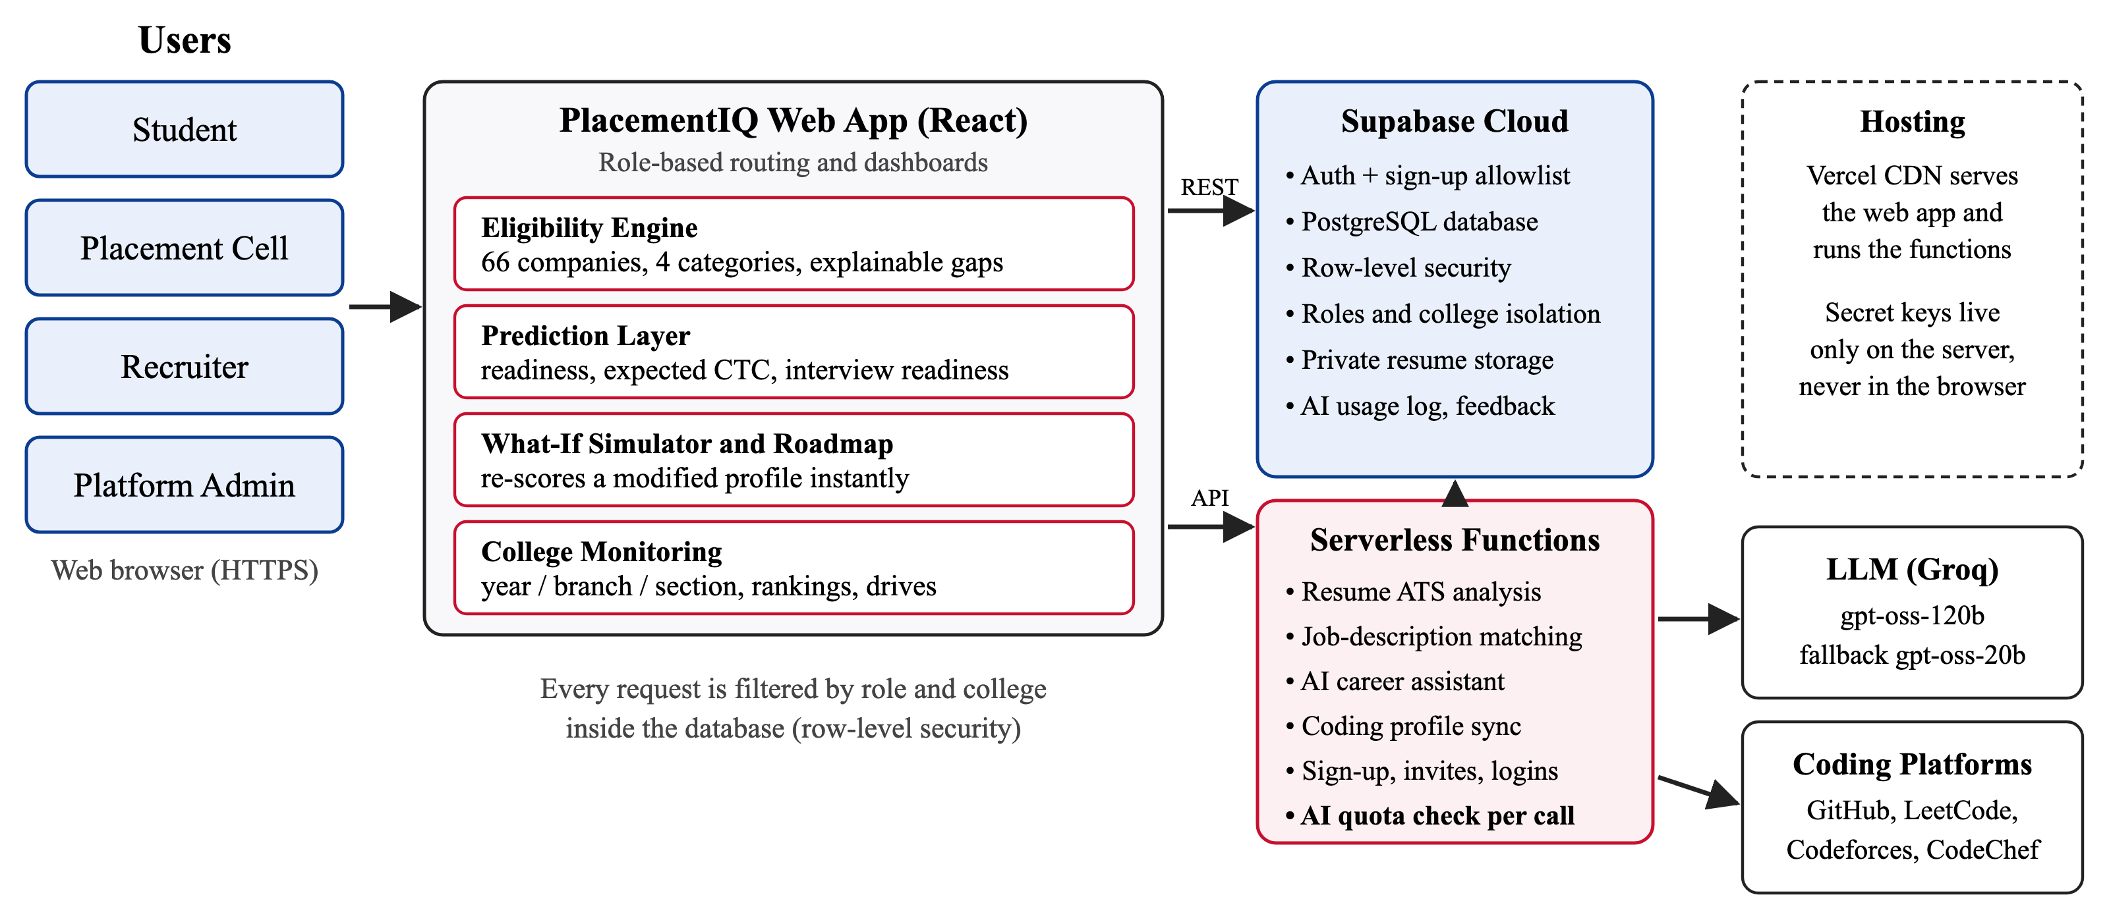
SYSTEM ARCHITECTURE

Slide 11
IMPLEMENTATION / METHODOLOGY
1. College Onboarding
Platform admin creates the college; placement cell uploads the roster (e-mail, roll no., branch, year, section).
2. Student Onboarding
Rostered students sign up, complete profile, upload resume and link coding profiles.
3. Data Processing
Resume parsed and scored (6 ATS checks via LLM); GitHub, LeetCode, Codeforces, CodeChef synced.
6. Placement Actions
Cell posts drives, ranks students, monitors classes; recruiters shortlist; feedback loop.
5. Predictions & Guidance
Readiness, expected CTC, interview readiness, What-If, roadmap and AI assistant.
4. Eligibility Engine
Profile scored against 66 recruiters and college drives; 4 categories with exact gaps.

Slide 12
ALGORITHM / METHODOLOGY
Input: CGPA, backlogs, Class X/XII %, 8 skill levels, projects, internships, resume and coding statistics.
Compute academic score A, skill score S (every point below a required level costs 1.2), experience E and projects P.
Match score M = 0.15A + 0.60S + 0.10E + 0.15P for each of the 66 companies.
Assign category: Eligible (M ≥ 88, largest gap ≤ 5), Nearly (M ≥ 75, gap ≤ 15), Can Become (M ≥ 55 or near academic cut-off), else Not Eligible.
Explain every decision with unmet criteria and gaps; compute readiness, expected CTC and interview readiness.
What-If: re-run the same steps on a modified profile and show which companies move up.
Key Formulas
A = 25 [min(1, g/g*) + min(1, X/X*) + min(1, XII/XII*) + b]
S = 100 − 1.2 Σ max(0, req − level)
M = 0.15A + 0.60S + 0.10E + 0.15P
Readiness = mean M over target companies
Expected CTC = Σ w·CTC / Σ w, w = category weight × M
Interview = 0.3 DSA + 0.15 Apt + 0.15 SD + 0.2 Mock + 0.1 Resume + 0.1 Exp

Slide 13
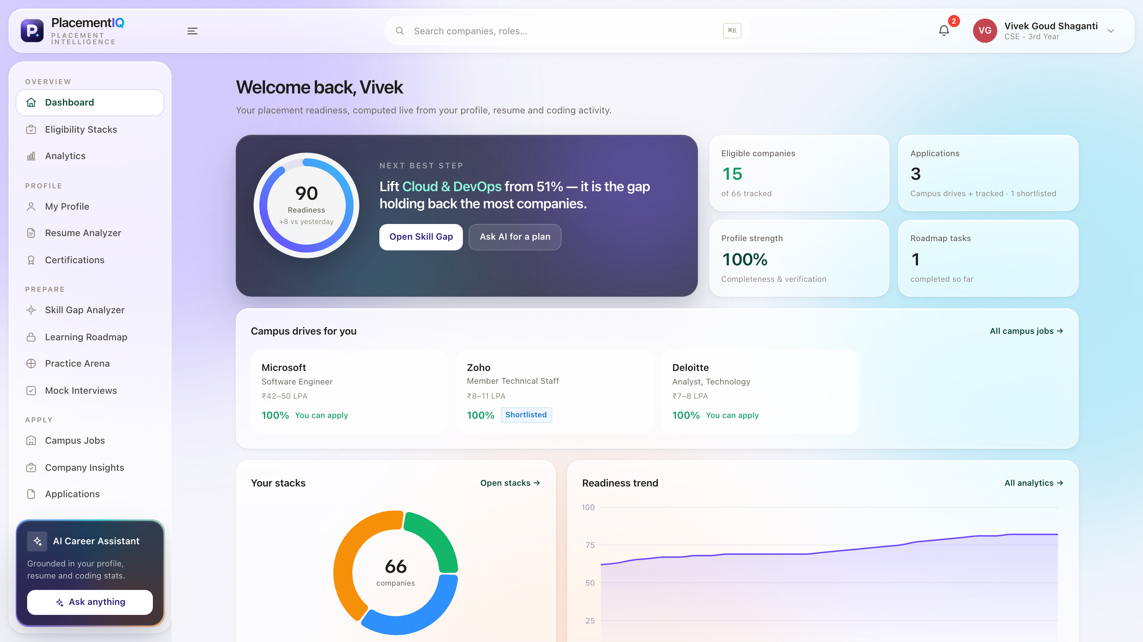
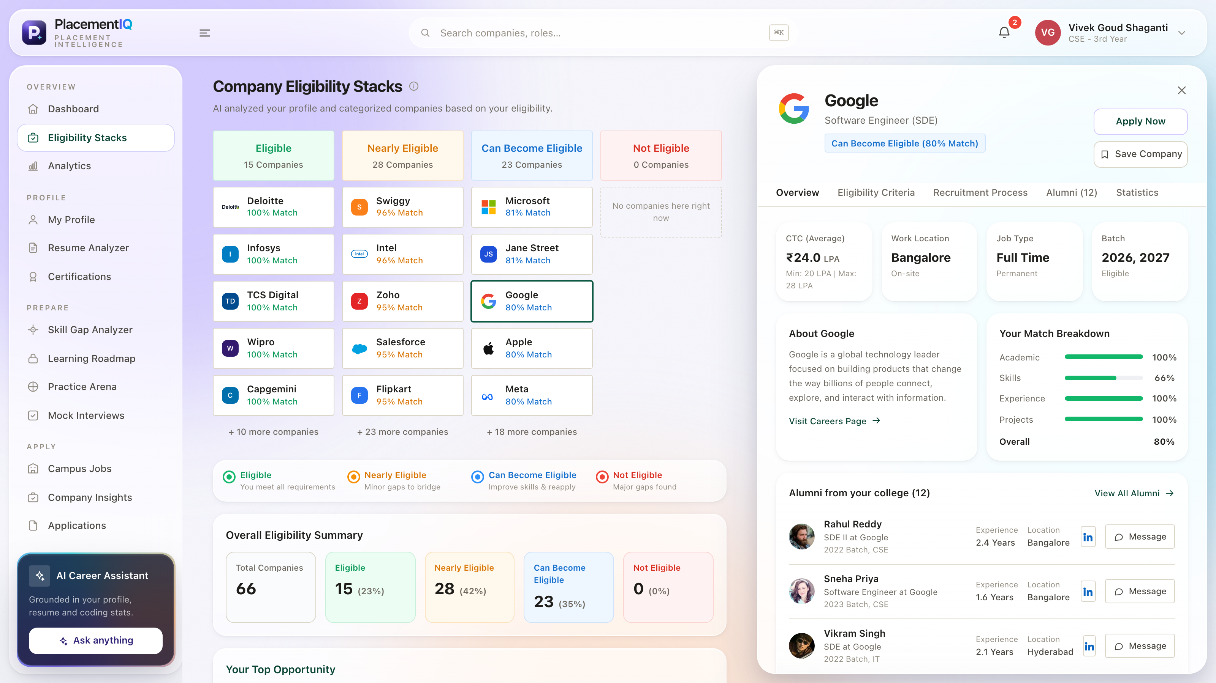
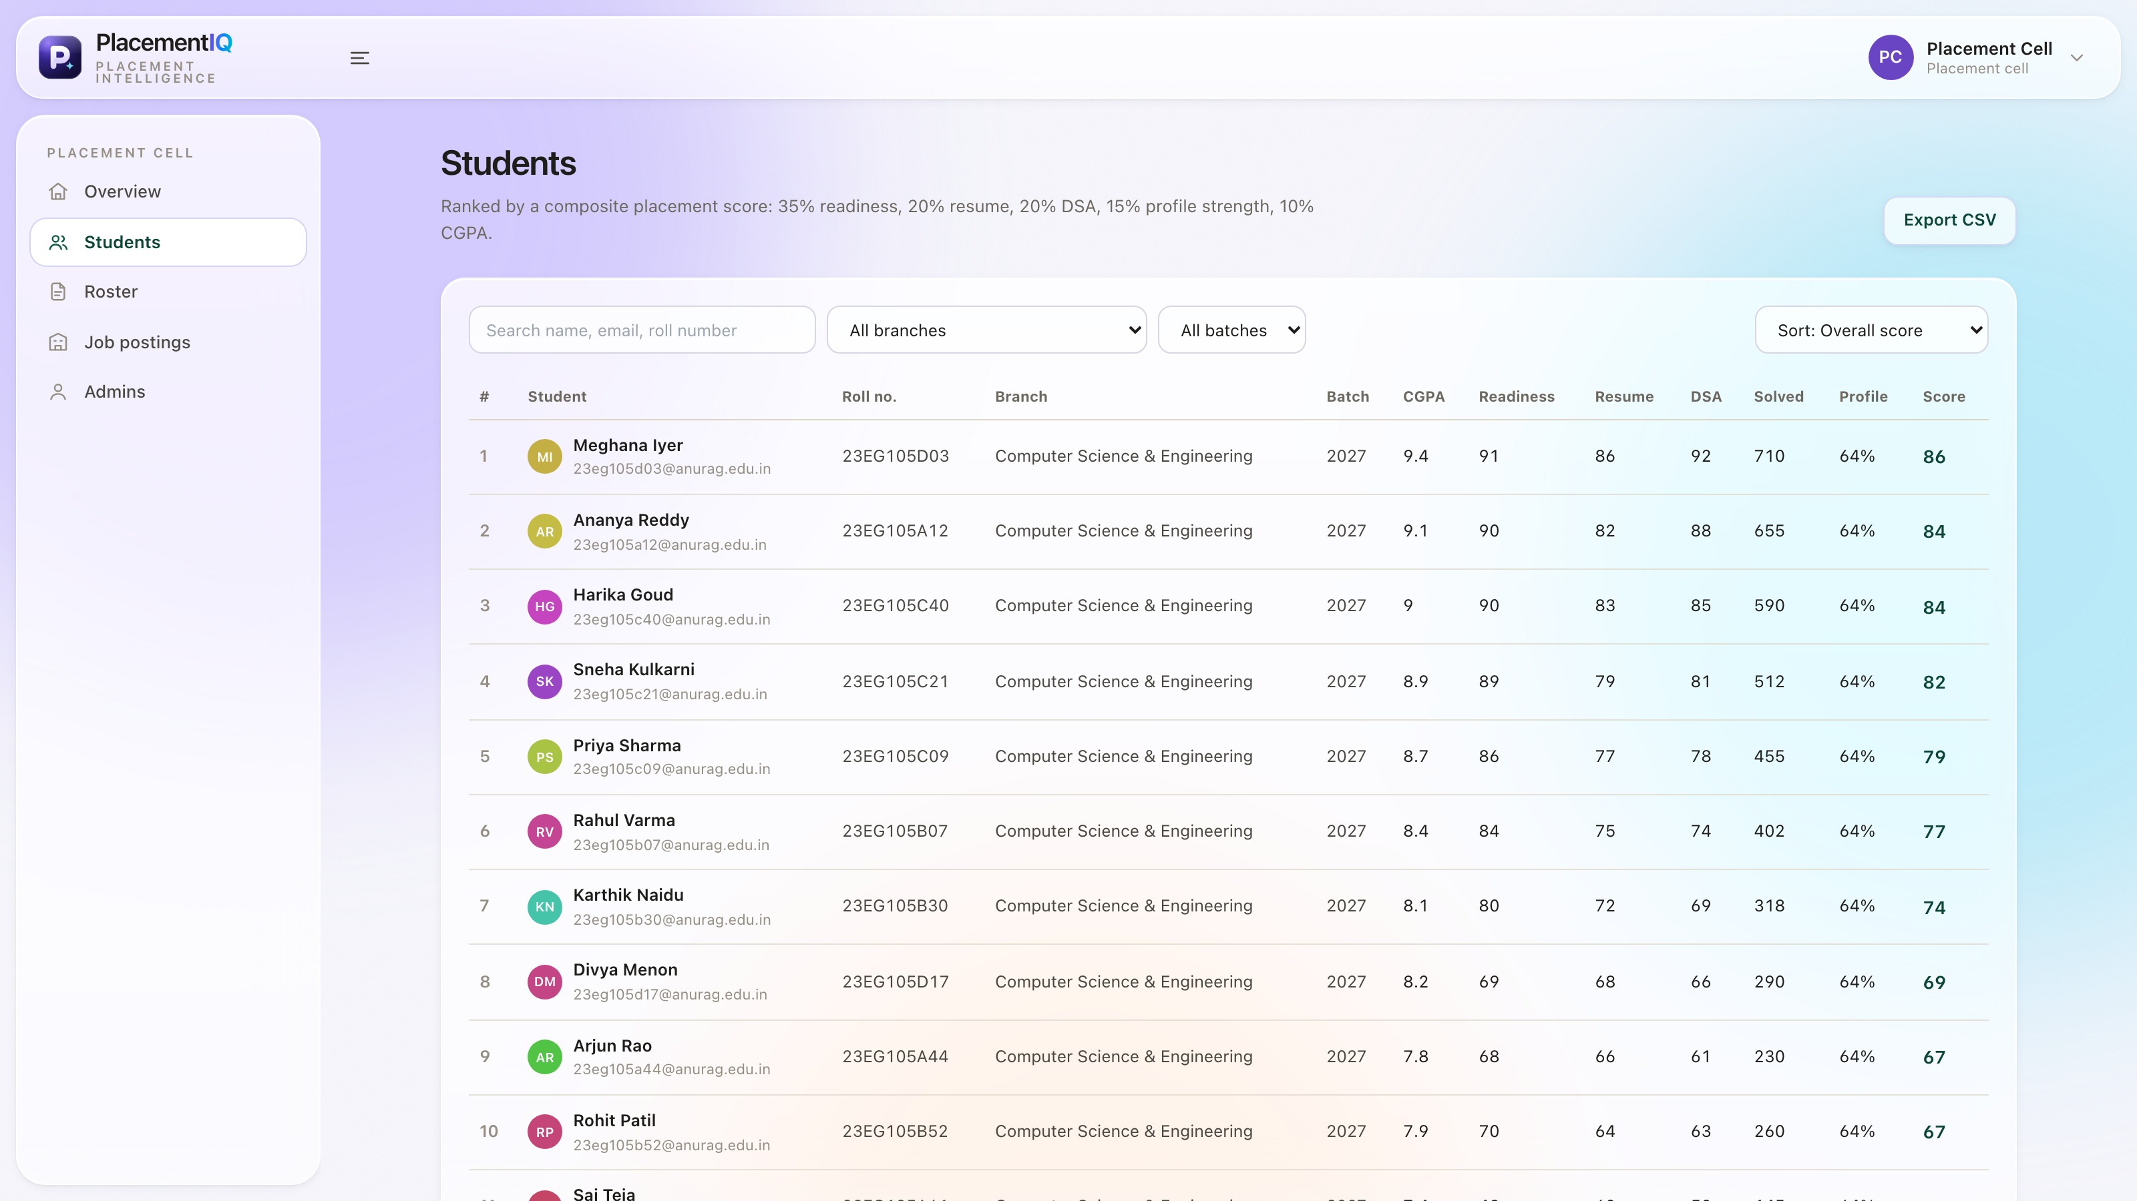
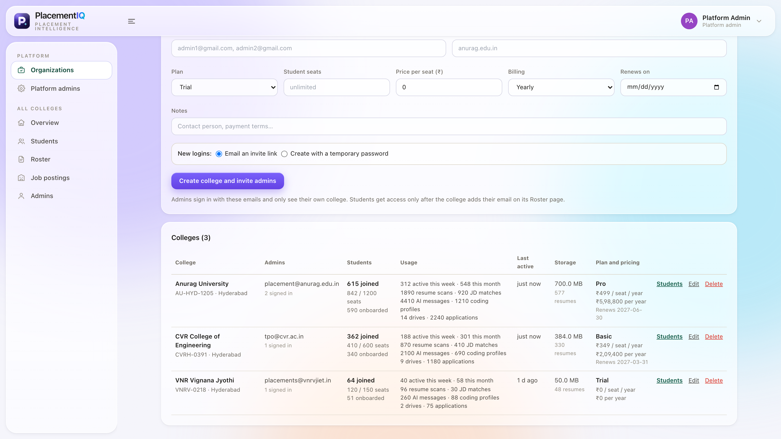
IMPLEMENTATION & SCREENSHOTS
Student dashboard
Eligibility stacks + company panel
Placement cell: ranked students
Platform admin: colleges and usage

Slide 14
RESULTS / OUTPUT
0.18 ms
to score one student against all 66 companies
100%
of 629,068 non-eligible decisions explained
0
monotonicity violations in 594,000 checks
19 / 19
access-control tests passed on the live database

Slide 15
TESTING
ID | Test Case | Type | Expected / Observed | Result
T1 | Sign-up with an unregistered e-mail | Security | Account creation rejected | Pass
T2 | Student sign-up with wrong roll number | Security | Rejected with clear message | Pass
T3 | Placement cell reads another college | Security | Only own college visible | Pass
T4 | Recruiter posts for another company | Security | Blocked by database policy | Pass
T5 | AI use beyond plan quota | Functional | Action refused after limit | Pass
T6 | Reason for every non-eligible result | Unit / property | 629,068 of 629,068 explained | Pass
T7 | Improving a skill never lowers a score | Property | 0 violations in 594,000 checks | Pass
T8 | Scoring speed per student | Performance | < 1 ms (measured 0.18 ms) | Pass
T9 | Role routing, What-If, filters on desktop and mobile | Functional (UI) | Correct pages and results | Pass
Security tests T1-T5 run against the live database inside a rolled-back transaction (19 scenarios, all passed).

Slide 16
CONCLUSION & FUTURE SCOPE
Conclusion
PlacementIQ replaces CGPA cut-off lists and scattered messages with explainable, per-company eligibility for every student.
Scores 66 companies in 0.18 ms, explains every non-eligible decision and never penalises improvement.
Revealed that 80.3% of cut-off-eligible pairs hide a major skill gap.
Role-based access keeps every college and recruiter isolated (19/19 tests).
Future Scope
Pilot across all batches at Anurag University and train a learned model on real outcomes.
Interview scheduling, offer tracking and faculty mentor roles.
Mobile app, single sign-on and multi-college analytics.
Scale on AWS with fairness audits and DPDP Act 2023 compliance.

Slide 17
REFERENCES
F. B. Kunwar et al., "Enhanced student placement prediction and skill recommendation system using CNN-BiLSTM with attention networks," Proc. IEEE ICISS, 2025, pp. 1450-1456.
Y. Mashayekhi, N. Li, B. Kang, J. Lijffijt, and T. De Bie, "A challenge-based survey of e-recruitment recommendation systems," ACM Comput. Surv., vol. 56, no. 10, 2024.
A. José-García et al., "C3-IoC: A career guidance system for assessing student skills using machine learning and network visualisation," Int. J. Artif. Intell. Educ., vol. 33, 2023.
M. S. A. Basha et al., "Unraveling campus placement success integrating exploratory insights with predictive machine learning models," Proc. IEEE CSITSS, 2023.
S. Tanberk et al., "Resume matching framework via ranking and sorting using NLP and deep learning," Proc. IEEE UBMK, 2023, pp. 453-458.
R. Alamri and B. Alharbi, "Explainable student performance prediction models: A systematic review," IEEE Access, vol. 9, pp. 33132-33143, 2021.
C. Qin et al., "Enhancing person-job fit for talent recruitment: An ability-aware neural network approach," Proc. ACM SIGIR, 2018, pp. 25-34.
R. S. Sandhu et al., "Role-based access control models," IEEE Computer, vol. 29, no. 2, pp. 38-47, 1996.
OpenAI, "gpt-oss-120b & gpt-oss-20b model card," arXiv:2508.10925, 2025.

Slide 18
Queries?

